Slide 1


CODING KITTENS
BUYMEE
VERSION 1.3.1

Slide 2

CODING KITTENS
OVERVIEW
An online marketplace and pet care service website - A reliable platform for pet lovers.
PROJECT MANAGEMENT
RESPONSIBILITY
PROBLEM STATEMENT
PRODUCT POSITION
USERS
MARKETS
USE CASE MODEL
NON-FUNC REQUIREMENTS
ARCHITECTURE
PACKAGE DIAGRAM
DESIGN UI
SOFTWARE TESTING

Slide 3


CODING KITTENS
TEAM MEMBERS
NGUYỄN THẾ THIỆN
LÂM THIỀU HUY
21127170
21127056
PROJECT MANAGEMENT
Project Manager
Back-end Developer
Business Analyst
,
ĐINH HOÀNG DUY
PHAN LÝ BAO HẠNH
21127027
21127039
Front-end Developer
UI Designer
Back-end Developer
Tester

Slide 4


CODING KITTENS
RESPONSIBILITY
NGUYỄN THẾ THIỆN:
ĐINH HOÀNG DUY
Responsible for project management,
coordinating activities, and making decisions in
the project. He is accountable for project
planning, scheduling, and resource management.
The Project Manager's tasks include project
planning, monitoring progress, and ensuring the
successful implementation of the project.
Responsible for developing the user interface and
designing visually appealing interfaces for the
application. The tasks of the Front-end
Developer/UI Designer include building
attractive and interactive user interfaces, ensuring
a good user experience, and integrating design requirements into the product.

Slide 5




CODING KITTENS
RESPONSIBILITY
,
LÂM THIỀU HUY
PHAN LÝ BAO HẠNH
Responsible for developing the server-side
software (back-end) and working as a business
analyst in the project. The tasks of the Back-end
Developer/Business Analyst include analyzing
business requirements, building server-side logic,
and ensuring that the application meets the
customer's needs.
Responsible for developing the server-side
software (back-end) and performing testing to
ensure the quality and performance of the
application. The tasks of the Back-end
Developer/Tester include building the database,
implementing server-side logic, and conducting
functional and performance testing of the
application.

Slide 6

POSITIONING
CODING KITTENS
THE PROBLEM OF
Problem Statement
The pet trend is becoming popular, but buying pets, especially pets with foreign origins, buying items and registering to do the necessary services still takes a lot of time and effort. It is because we have to get to a physical store for the goods, and sometimes the store does not sell those we need. Also, we might have to wait in a physical queue for pet care services.

Slide 7


CODING KITTENS
POSITIONING
Problem Statement
AFFECTS
THE IMPACT OF WHICH IS
Customers in the process of getting such services being inconvenient and time-consuming, especially for busy workers
Customers spend too much time and effort searching for the items or services they want.
Stores might lose revenue due to service overload and customer churn.
A SUCCESSFUL SOLUTION WOULD BE
Customers are able to view information and order online pets or pet essentials easily. In addition, it also provides the feature of scheduling pet services and door-to-door delivery at customers’ convenience. Stores could schedule appropriate services to serve customers and avoid service overload

Slide 8




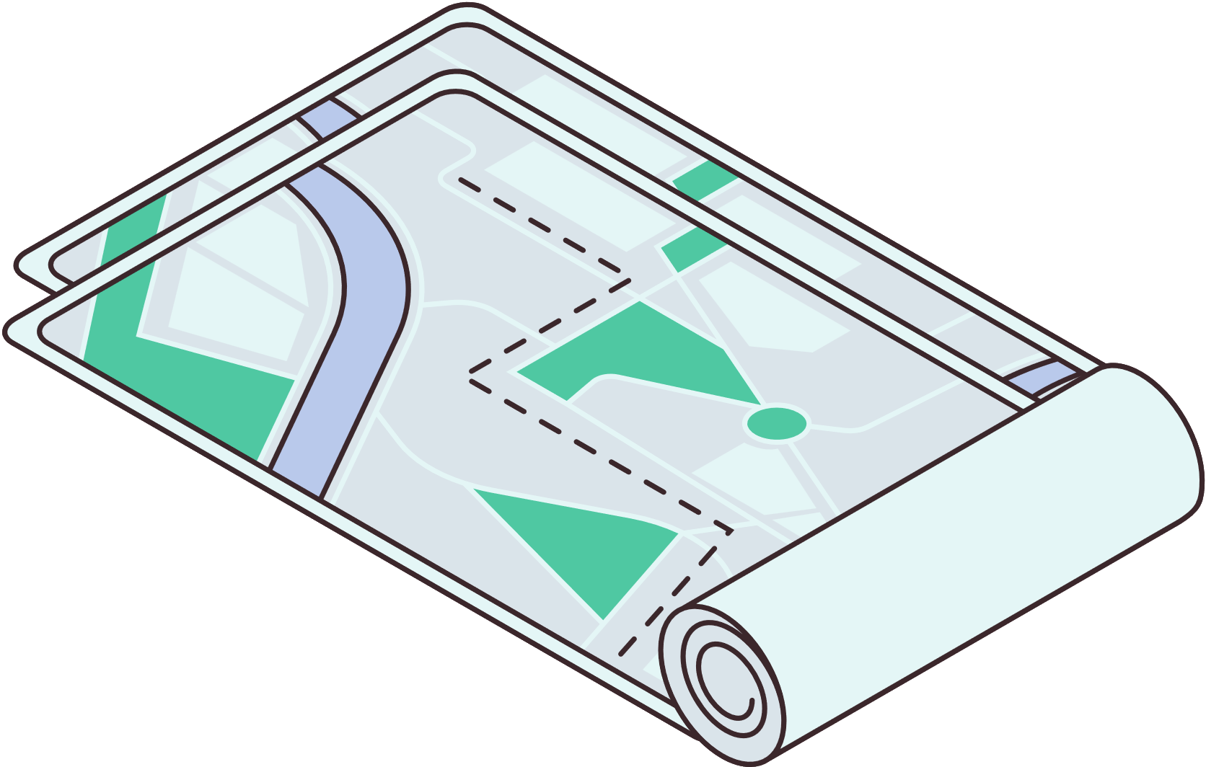

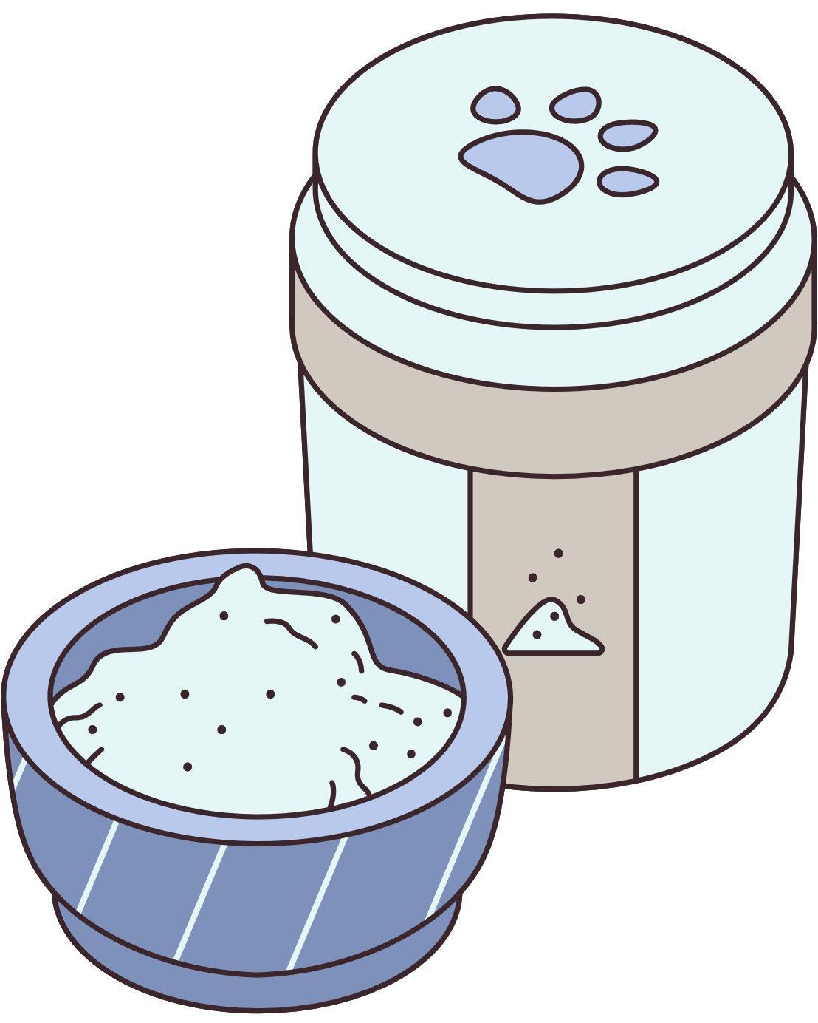
POSITIONING
CODING KITTENS
FOR
Customers who need to find pets or pet supplies and services.
Stores, where services can be overloaded.
Product Position Statement
WHO
Customers can search for pet breeds, order pets or supplies online, and have them delivered to their homes. In addition, customers are also provided with the feature of booking pet care services and items, exchanging pet experiences with other users.
Stores can schedule appropriate service to customers and notify customers of current items on sale.

Slide 9


CODING KITTENS
THE (PRODUCT NAME)
BUYMEE.COM
THAT
Customers can register and log in to their account, search and view products, add/remove/edit orders in cart, create/cancel orders, track orders, pay online/cash.
Stores can create/delete sales channels, add/delete/edit merchandise, wait for confirmation/confirmed/cancel orders, store sales statistics.
And customers can read guides on how to take care of the pets
UNLIKE
The pet health websites

Slide 10




CODING KITTENS
OUR PRODUCT :
is an e-commerce website that serves as a common marketplace for veterinary stores and pet care stores that open sales channels:
For customers: convenient to find what they want to buy or the services they want to use with reasonable prices, time, and places.
For stores: expand the trading market, easily approach customers and provide customers with the most attentive service
www.reallygreatsite.com

Slide 11


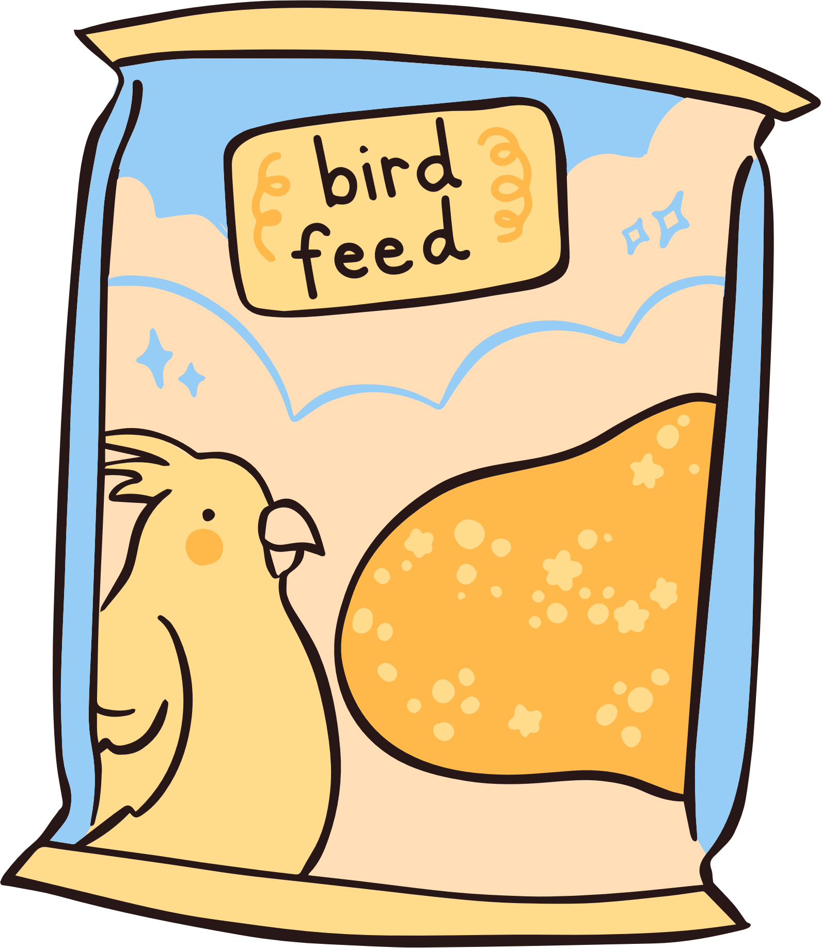
CODING KITTENS
USER :
Pet Owners: This is a group of people who have or are interested in owning a pet. They can be experienced pet owners or beginners who want to learn and have information about pet ownership. Take care and shop for your pet.
Pet Buyers: This is the group of people who are interested in buying a pet. They may be people who want a new pet or already have a pet but want to buy more with a special passion and love for pets. They may not have pets, but want to stay up to date with the latest on pet types, pet care trends, and products.

Slide 12






CODING KITTENS
MARKET:
Pet Market: This is a market related to the sale and purchase of all kinds of pets. This market can include pet stores, breeders, breeders, pet websites, and pet-related services such as care, nurturing and training.
Pet Products and Services Market: This is the market concerned with products and services for the care and upbringing of pets

Slide 13


CODING KITTENS
Guest
1.Sign up
6. Publish articles
5. Read articles
<<extend>>
12. Control website status
2.Log in
Manage product categorization
4. Search products
<<include>>
Check login information
<<extend>>
<<extend>>
<<extend>>
13. Manage user accounts
Add to temporary order
View products
Admin
Customer
11. Process user reports
3. Log out
16. Update order status
8. Manage order history
<<extend>>
10. Manage products
7. Confirm ordering
<<extend>>
Seller
Check order information
15. Post products
<<extend>>
9. Manage stores
USE CASE MODEL
<<extend>>
Purchase
Check store statistics
<<extend>>
14. Add stores
<<extend>>

Slide 14



CODING KITTENS
NON-FUNCTIONAL REQUIREMENTS
Applicable standards
The website is initially developed for running on the latest version of Google Chrome browser as of this document
Written: 116.0.5845.14 (Friday, June 30, 2023) on the client side.
Further browser additions will be updated.

Slide 15


CODING KITTENS
NON-FUNCTIONAL REQUIREMENTS
SYSTEM STANDARDS
The client component of the website shall not exceed 1GB of RAM
The client component of the website shall be run on a computer with a graphical screen.
The client component of the website requires a usable mouse and keyboard.
The client component of the website shall run on Windows 10 and Windows 11.

Slide 16

NON-FUNCTIONAL REQUIREMENTS
CODING KITTENS
PERFORMANCE REQUIREMENTS
The website shall serve at most 50 customers at the central server at any given time.
The website shall provide service with no more than a 10-second latency.
The website shall complete transferring an order and transaction for such order within 1 minute from when the user confirms with the order.
ENVIRONMENTAL REQUIREMENTS
None
DOCUMENTATION REQUIREMENTS
Permit on online business (following the Digital Business law of 01/2021/NĐ-CP by the Vietnamese Government)

Slide 17




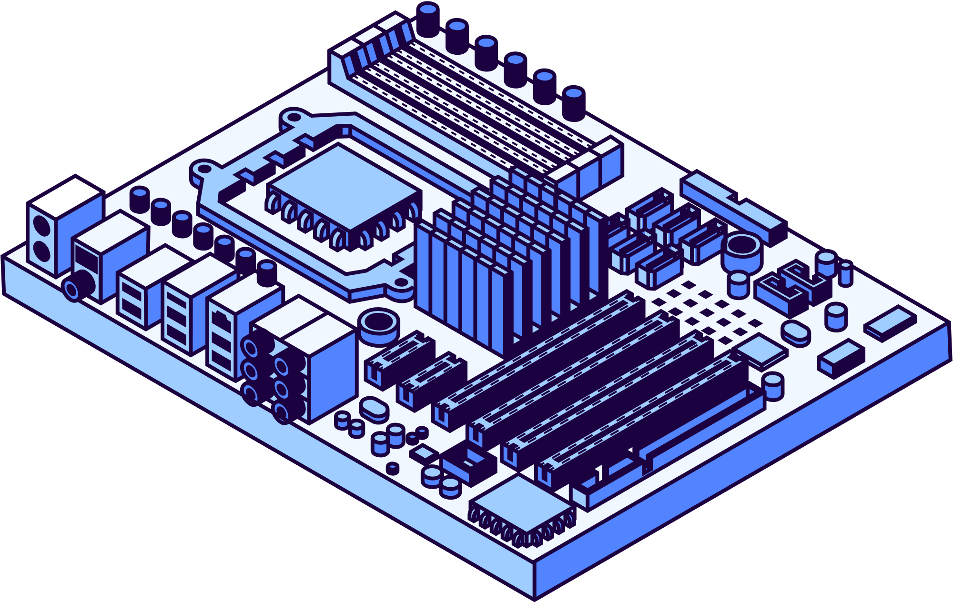




CODING KITTENS
ARCHITECTURE AND CONSTRAINTS
Technology
Data
Model
ReactJS, NodeJS, PostgreSQL, Vite.
Using the Postgres database.
Using the MVC pattern.
Environment
Easy to use
Used for web environment, supports most browsers.
Friendly interface, users can get used to it after the first few minutes of use

Slide 18




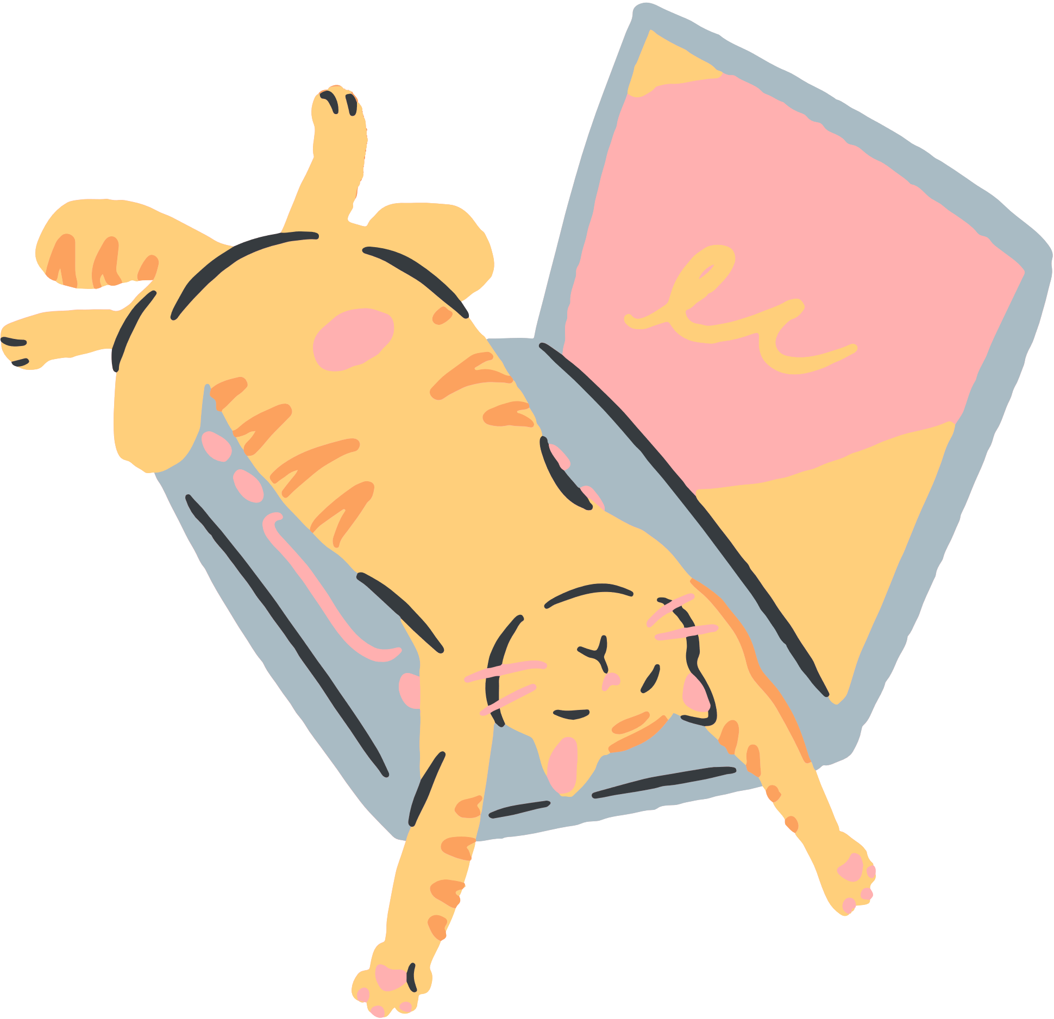


CODING KITTENS
CODING KITTENS
PACKAGE DIAGRAM
Server
Front end
View
Back end
App.js
Navbar.js
Footer.js
ArticlesPage.js
CartPage.js
SignupPage.js
HomePage.js
SearchPage.js
ProfilePage.js
ProductPage.js
CustomerPage.js
ShopPage.js
AdminPage.js
Controller
Model
Database
ShopController
ArticleController
ProductController
OrderController
UserController
AdminController
Order
Order_Detail
Product
Shop
User
Article
Order
Order_Detail
Product
Shop
User
Article
Client browser

Slide 19

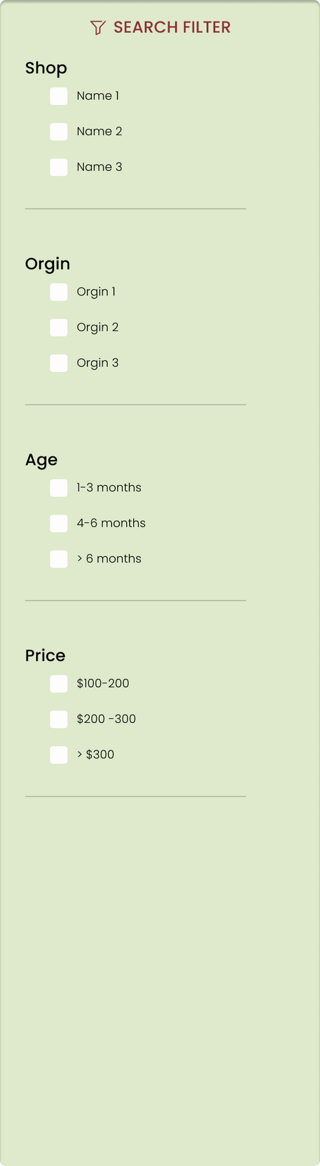
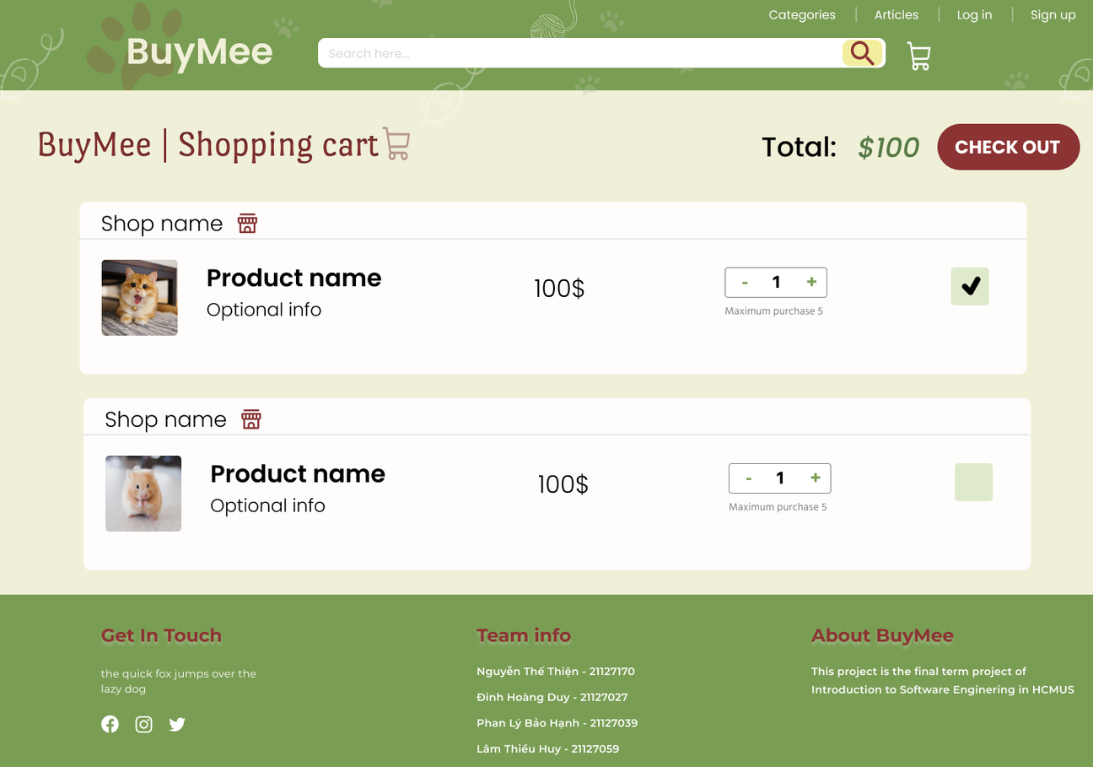

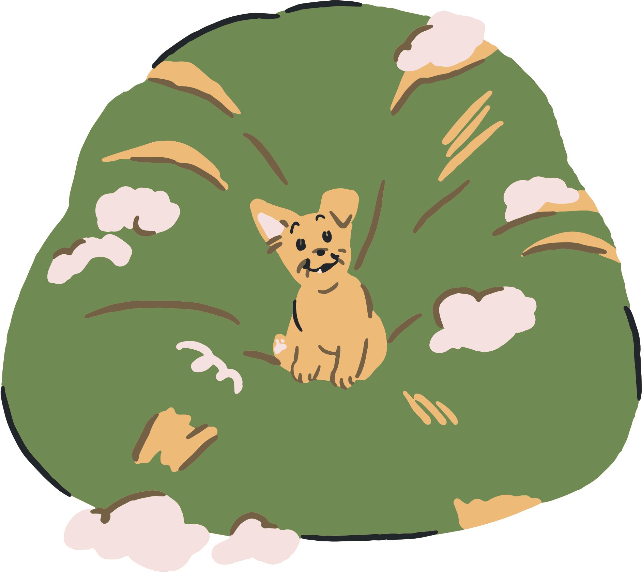
CODING KITTENS
CODING KITTENS
DESIGN UI
Figma is used by the Coding Kittens team as the main tool for interface design because of its popularity and ease of use.
2. Filter of SearchPage
CartPage

Slide 20
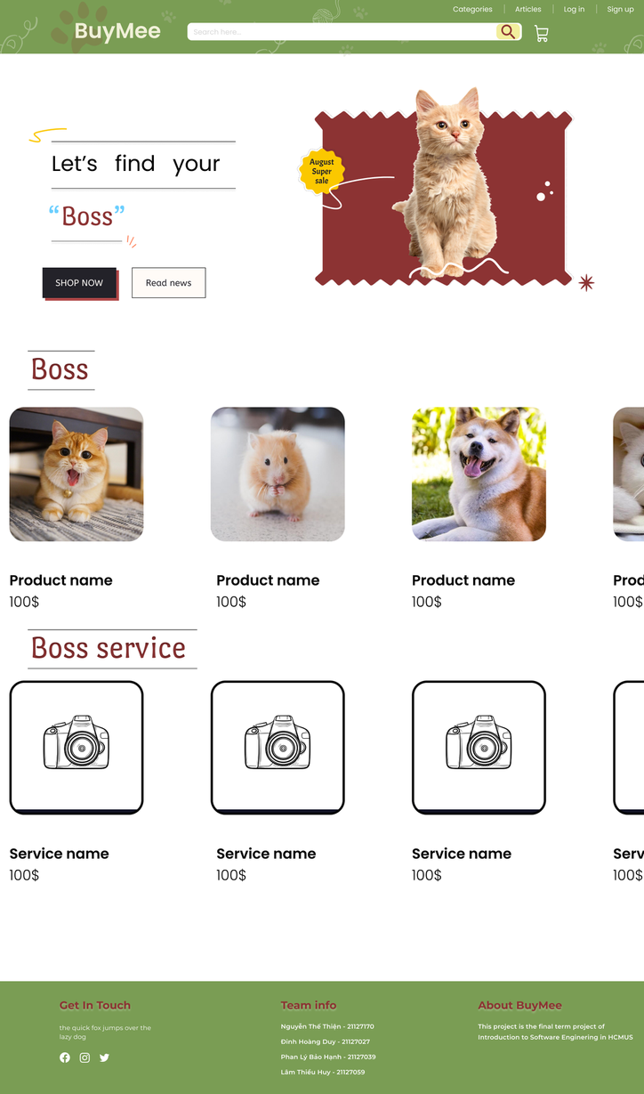
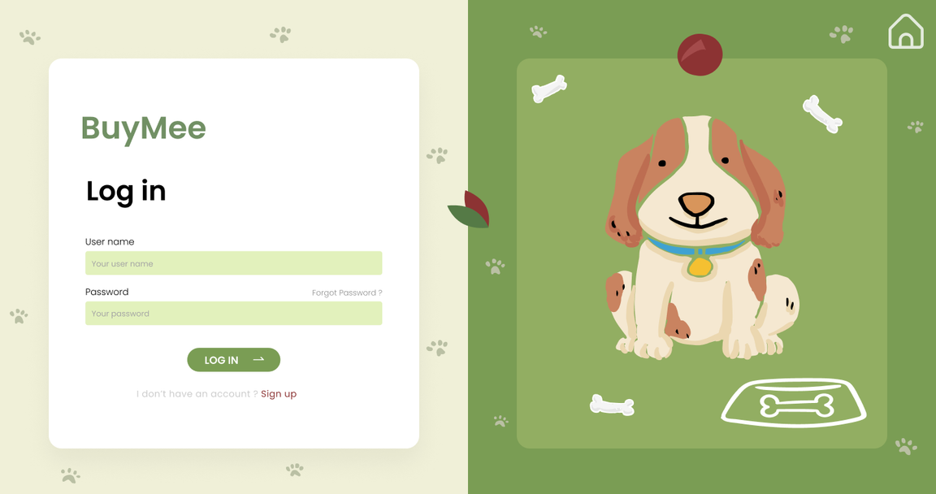

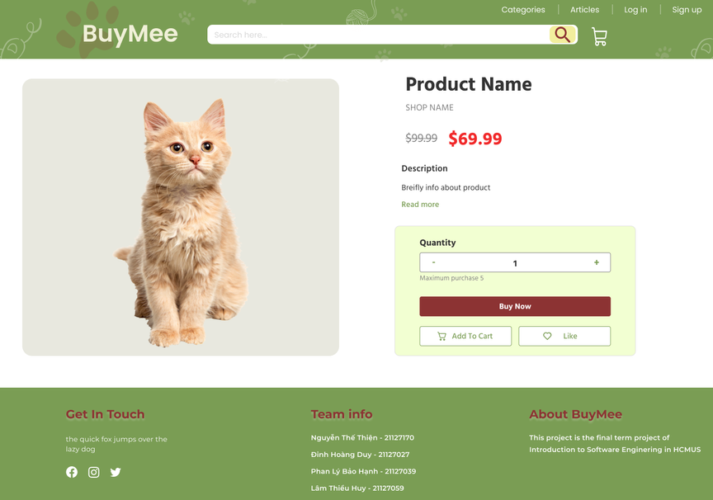

CODING KITTENS
4. Log in
3. Homepage
5. Product page

Slide 21
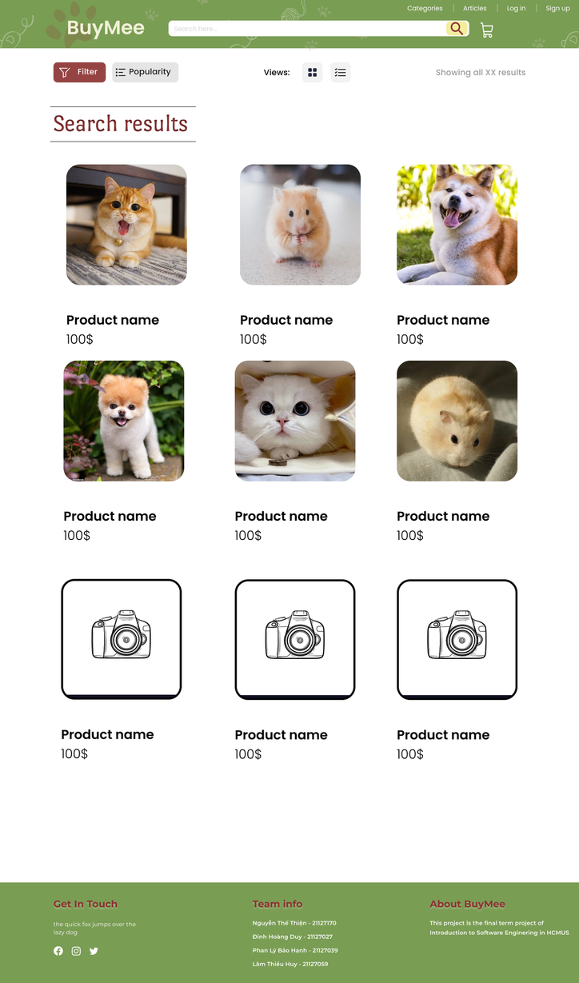
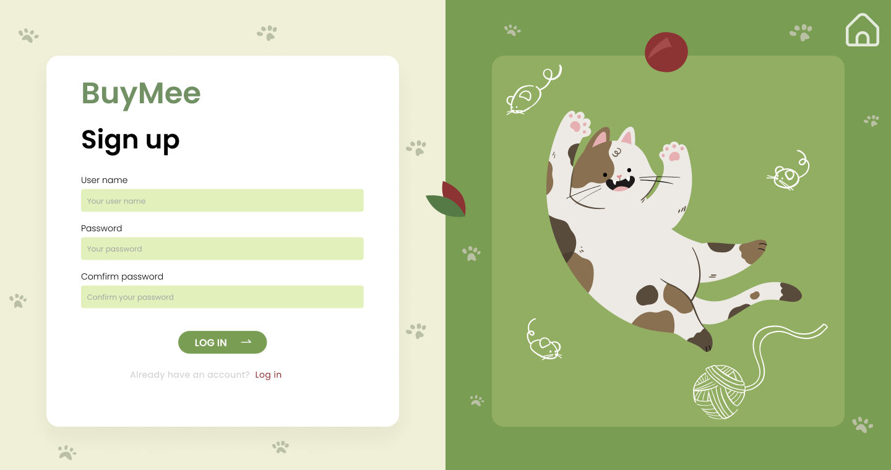

CODING KITTENS
7. Sign up
6. Search page
CODING KITTENS

Slide 22








CODING KITTENS
SOFTWARE TESTING
TESTING METHODS
SUPPORT TOOLS
Manual: Team members test the main functions and then record it via Google sheet
Google docs
Google sheet
TESTING ENVIRONMENTS
Google Chrome
Firefox
Microsoft Edge
Opera

Slide 23









CODING KITTENS
Control website status
Check shopping cart
TARGET TEST ITEMS
View product
Sign up
Add to cart
Log in
Search product

Slide 24


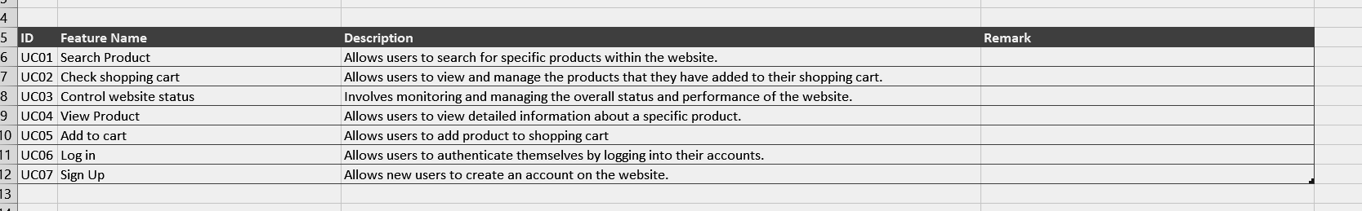

CODING KITTENS
TEST PLAN
FEATURES
Number of features: 7
Number of test cases: 31
Each feature from 3-6 test cases
Each test case is tested manually.

Slide 25


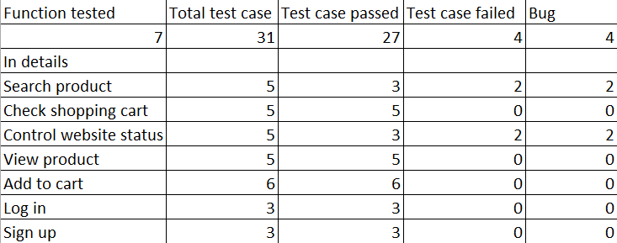

CODING KITTENS
TEST SUMMARY

Slide 26


DEMO
CODING KITTENS

Slide 27
CODING KITTENS
THANK YOU
We sincerely appreciate your interest and willingness to support. We hope that our online marketplace and pet care service website will meet your needs and bring joy and comfort to you and your beloved furry companions. Thank you once again, and have a wonderful day!
BY CODING KITTENS
Thesis Defense Presentation Template

